Slide 1

Total Variation Minimization with ADMM
Team - DYNAMIC DUDES
Team - DYNAMIC DUDES
AIE19013
AIE19014
AIE19062
Charan Tej. K
Ch. Surya Teja
Sugash T.M

Slide 2
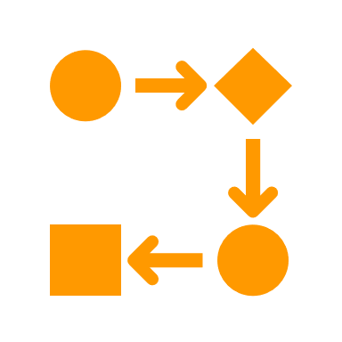






STEP 02
STEP 04
STEP 06
Working with ADMM
Implementation
Applications
STEP 01
STEP 03
STEP 05
STEP 07
Introduction
TV with ADMM
Graphical Representation
Conclusion

Slide 3
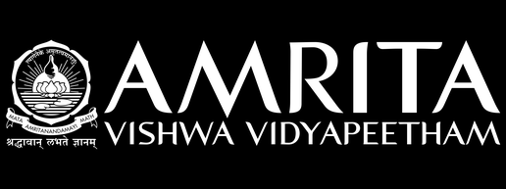
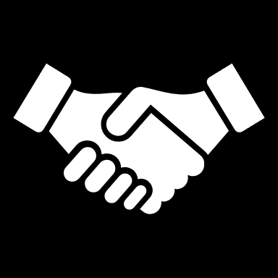
Introduction

Slide 4


Introduction
Total variation minimization also known as Total variation denoising is an approach for noise reduction developed so as to preserve sharp edges in the underlying signal
Popularly known as total variation regularization , it is used in digital image processing
Total variation is used not just for denoising, but for more general signal restoration problems, including deconvolution, interpolation, in-painting, compressed sensing, etc.

Slide 5
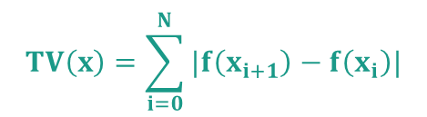
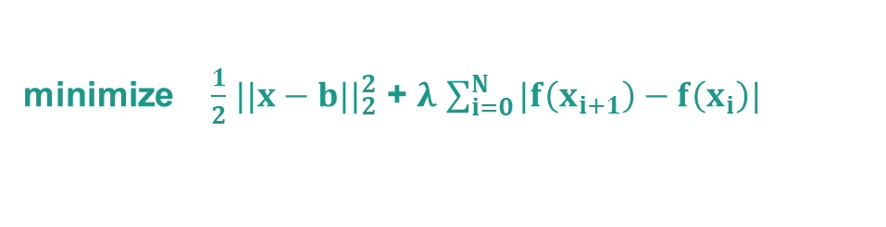
Introduction
Total variation (TV) is the sum of absolute value of adjacent differences:
$$TV\left(x\right)=\sum_{i=0}^{N}{|f\left(x_{i+1}\right)−f\left(x_{i}\right)|}$$
Formally, the whole denoising problem looks like this
minimize $\frac{1}{2}$ $||{x−b||}_{2}^{2}$ + $λ$ $\sum_{i=0}^{N}{|f\left(x_{i+1}\right)−f\left(x_{i}\right)|}$

Slide 6
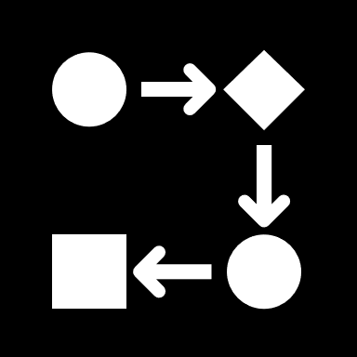
Working with ADMM

Slide 7
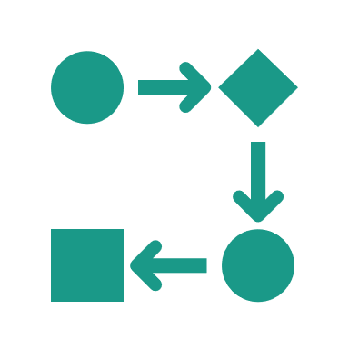
Working with ADMM
Alternating Direction method of multipliers (ADMM) is known as one of the most efficient methods for solving convex problems. The main goal of ADMM is to bring back the decomposability property of our augmented lagrangian objective function by adding an extra function to it.
The key to use ADMM is the separable terms in given function. This allows the whole problem to be solved by iterating over the two sub-problems. A general notation of ADMM can be visualized as follows :
Minimize f(x) + g(z)
Subject to Ax + Bz – c = 0

Slide 8
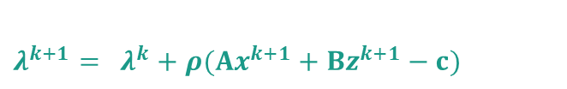
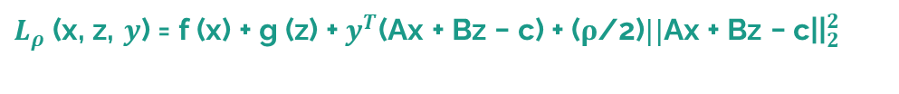

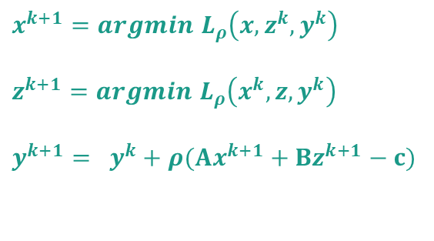
Working with ADMM
As in method of multipliers , we can construct our augmented lagrangian function of:
$L_{ρ}$(x, z, $y$) = f (x) + g (z) +${ y}^{T}$(Ax + Bz − c) + (ρ/2)$||{\text{Ax}\text{ + }\text{Bz}\text{ − }\text{c}\text{||}}_{2}^{2}$
Now , ADMM iterates through each and every variable in the following ways:
$x^{k+1}=argmin$ $L_{ρ}\left(x,z^{k},y^{k}\right)$
$z^{k+1}=argmin$ $L_{ρ}\left(x^{k}, z,y^{k}\right)$
$y^{k+1}= y^{k}+$ $ρ(Ax^{k+1}+Bz^{k+1}−c)$
Note
Here, we consider lagrange multiplier as $y^{T}$, where transpose has been considered, in order to satisfy the dimensions of the resultant matrix.

Slide 9
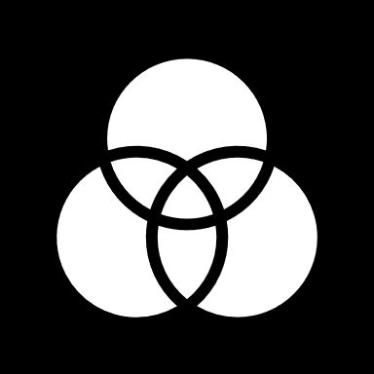
Total variation with ADMM

Slide 10

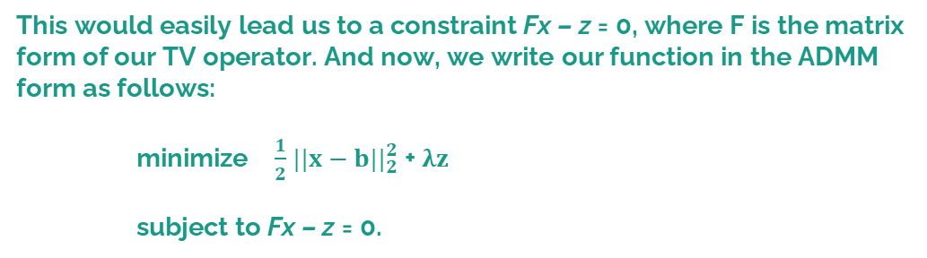
Total variation with ADMM
To perform ADMM on Total variation function, we need to write our problem closer to it. We also create a variable ‘z’ since we only have one variable (x) in our problem of total variation denoising function.
This would easily lead us to a constraint Fx – z = 0, where F is the matrix form of our TV operator. And now, we write our function in the ADMM form as follows:
minimize $\frac{1}{2}$ $||{x−b||}_{2}^{2}$ + $λz$
subject to Fx – z = 0.
We can compare the functions of conventional ADMM, with our newly above formulated equations.

Slide 11
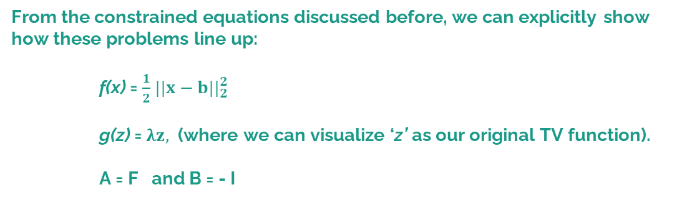
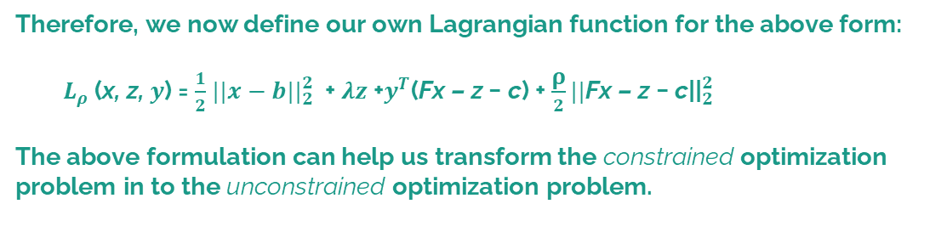
Total variation with ADMM
From the constrained equations discussed before, we can explicitly show how these problems line up:
f(x) = $\frac{1}{2}$ $||{x−b||}_{2}^{2}$
g(z) = $λz,$ (where we can visualize ‘z’ as our original TV function).
A = F and B = - I
Therefore, we now define our own Lagrangian function for the above form:
${ L}_{ρ}$(x, z, $y$) = $\frac{1}{2}$ $||{x−b||}_{2}^{2}$ + $λz$+$y^{T}$(Fx – z − c) + $\frac{\text{ρ}}{2}||{\text{Fx}\text{ – }\text{z} \text{− }\text{c}\text{||}}_{2}^{2}$
The above formulation can help us transform the constrained optimization problem in to the unconstrained optimization problem.

Slide 12
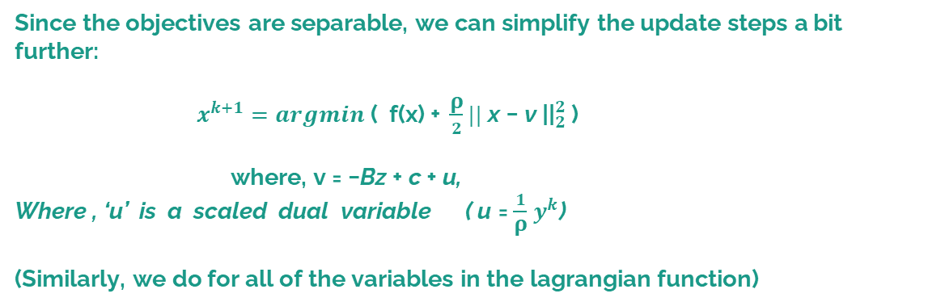
Total variation with ADMM
Since the objectives are separable, we can simplify the update steps a bit further:
$x^{k+1}=argmin \text{(} \text{f}\text{(}\text{x}\text{) + }\frac{\text{ρ}}{2}||{ \text{x}\text{ − }\text{v} \text{||}}_{2}^{2}$ )
where, v = −Bz + c + u,
Where , ‘u’ is a scaled dual variable ( u = $\frac{1}{\text{ρ}}$ $y^{k}$)
(Similarly, we do for all of the variables in the lagrangian function)
We have now split our function into two subproblems, so that it much more easier for us to solve our original problem. We also see that with each individual update we're only minimizing with respect to one variable, as our since our objective function is separable, this greatly simplifies the problem.
Notice that ADMM has helped us to decompose the function, even though we add penalty function for violating the constraints in the beginning!

Slide 13
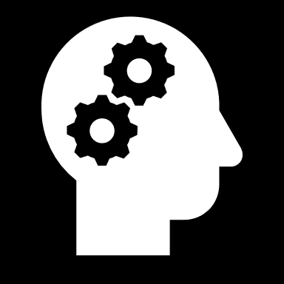
Implementation

Slide 14

Implementation
At first we import some important dependencies like SciPy, NumPy, Matplotlib.
Next, we defined a function which solves the total variation problem with the help of our ADMM function which returns the minimized values.
For solving the raw total variation, we have defined another function called Total variation objective so that it returns the solution of total variation function.

Slide 15
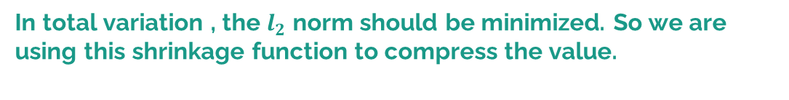
Implementation
We have another function called ‘ Shrinkage ’ , this function is used for soft-thresholding (moves all values of its input toward 0).
In total variation , the $l_{2}$norm should be minimized. So we are using this shrinkage function to compress the value.
Next we will generate some random data on which we are going to apply our total variation function which we have defined using ADMM.

Slide 16
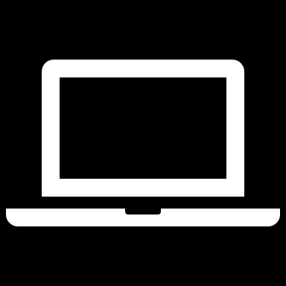
Graphical Representation

Slide 17

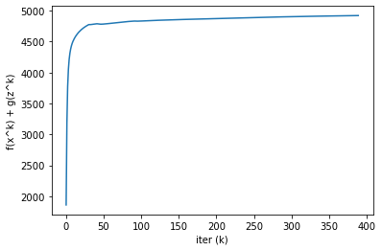
Graphical Representation
Variation of our Total variation function over all iterations

Slide 18
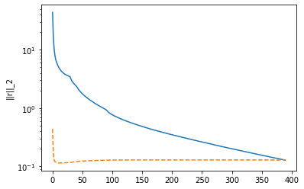
Graphical Representation
Values of r_norm and eps_prim over iterations

Slide 19
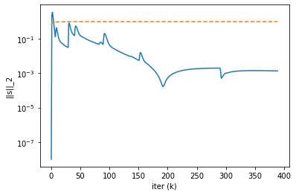
Graphical Representation
Values of s_norm and eps_dual over iterations

Slide 20
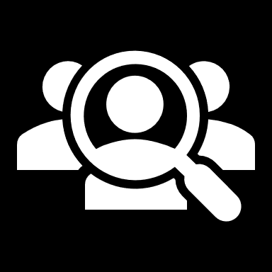
Applications

Slide 21

Applications
Total variation minimization is used in Digital image processing, it helps in removing noise from the image:
The famous image of the first Black hole was denoised by using this Total Variation minimization process, developed by Rudin-Osher-Fatemi.
Total variation minimization also has its branches in fields of communication technology, such as removing the noise from the speech and video signals.
The restoration of images are obtained with regularization methods involving TV operators

Slide 22

Conclusion
Finally, we conclude by saying that we as a team have successfully implemented Total Variation Minimization using ADMM as the minimization technique. We have also learnt how Denoising techniques work exactly for image deconvolution
As a part of future enhancement, we would like to extend this project towards much more popular and robust algorithms such as MM algorithm to deduce Total Variation.

Slide 23

☺☺☺☺☺☺☺☺☺☺☺☺☺☺☺☺☺☺☺☺
☺☺☺☺☺☺☺☺☺☺☺☺☺☺☺☺☺☺☺☺

